Slide 1

Udemy Financial Courses Analysis
An analysis of Udemy's financial courses was conducted

Slide 2


Team Members
ABDELRAHMAN ASHOUR
SAHER MOHHAMMED

Slide 3
Agenda
SCENARIO AND DATASET DESCRIPTION: INTRODUCTION TO THE PROJECT SCENARIO, OUTLINING THE OBJECTIVE AND CONTEXT OF THE UDEMY COURSES ANALYSIS, DESCRIPTION OF THE DATASET.
DATA CLEANING: THE INITIAL STEP INVOLVES PROCESSING DATETIME FEATURES FOR UNIFORMITY, CONVERTING VARIOUS CURRENCIES INTO USD FOR COMPARABILITY, EXTRACTING PERCENTAGE DISCOUNTS OFFERED ON COURSES FOR BETTER VALUE ANALYSIS, IMPUTING MISSING VALUES TO MAINTAIN DATA INTEGRITY, AND CATEGORIZING COURSES INTO SPECIFIC FIELDS.
COURSE CATEGORIZATION: EACH UDEMY COURSE IS ASSIGNED TO A SPECIFIC CATEGORY USING A BESPOKE FUNCTION, 'CATEGORIZE_TITLE', ENSURING PRECISE ANALYSIS PER DOMAIN—RANGING FROM TECHNICAL SUBJECTS LIKE DATABASE MANAGEMENT AND DATA SCIENCE TO SOFT SKILLS LIKE LEADERSHIP AND COMMUNICATION.
ANALYSIS: USING PLOTLY EXPRESS, A DATA VISUALIZATION TOOL, THE DATA SET IS ANALYZED TO UNCOVER PATTERNS AND TRENDS THAT INFORM THE STATUS AND PROSPECTS OF UDEMY'S COURSE OFFERINGS.
DASHBOARD CREATION: THE CLEANED AND CATEGORIZED DATA IS THEN SYNTHESIZED INTO A POWER BI DASHBOARD, OFFERING A DYNAMIC AND INTERACTIVE VISUAL REPRESENTATION OF THE COURSES' DATA THAT HIGHLIGHTS KEY PERFORMANCE INDICATORS AND INSIGHTS.
INSIGHTS AND TAKEAWAYS: THE POWER BI DASHBOARD SERVES AS A BASIS FOR SUMMARIZING FINDINGS, OFFERING BOTH A BIG PICTURE AND GRANULAR INSIGHTS INTO THE UDEMY COURSES. IT ALSO FACILITATES THE DERIVATION OF ACTIONABLE RECOMMENDATIONS FOR COURSE PROVIDERS TO ENHANCE THEIR OFFERINGS.

Slide 4


Project Objectives
SCENARIO
In this presentation, we will dive into the key insights from the Udemy courses analysis dashboard. We will explore the revenue generated by the courses, enrollment figures, student reviews, and course popularity. This data can help us understand student preferences and identify areas for improvement.

Slide 5
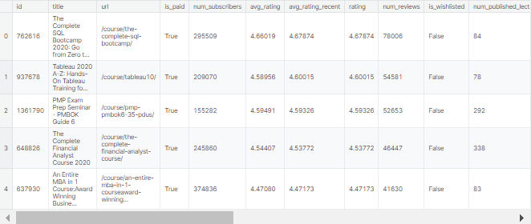
Dataset Overview Before Processing

Slide 6
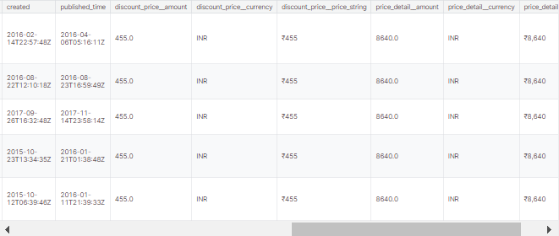
Dataset Overview Before Processing
Data Link on Kaggle

Slide 7
Data Cleaning for Udemy Financial Courses Analysis
DATE/TIME FORMATTING
Ensuring uniform representation of datetime features across the dataset for consistency.
CURRENCY CONVERSION
Converting course prices from various currencies into USD to enable fair value comparison.
DISCOUNT EXTRACTION
Extracting percentage discounts offered on courses to analyze cost-effectiveness and potential savings.
MISSING VALUE IMPUTATION
Filling in missing data points through appropriate imputation techniques to maintain data integrity.
COURSE CATEGORIZATION
Categorizing courses into specific fields or domains for targeted analysis and insights.

Slide 8
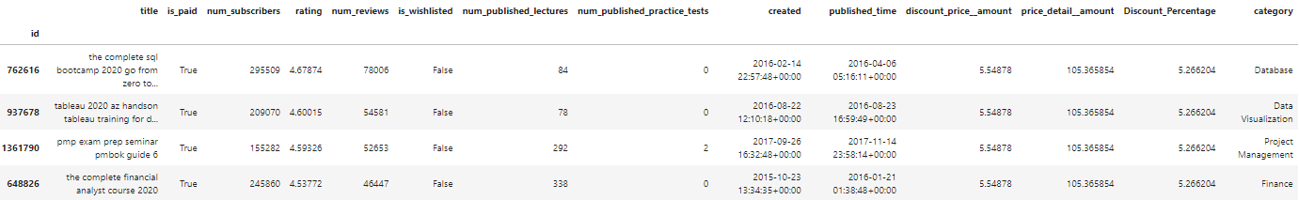
Dataset Overview After Processing
Notebook Link on Kaggle

Slide 9
INSIGHTS AND TAKEAWAYS
Dashboard Overview and Insights

Slide 10
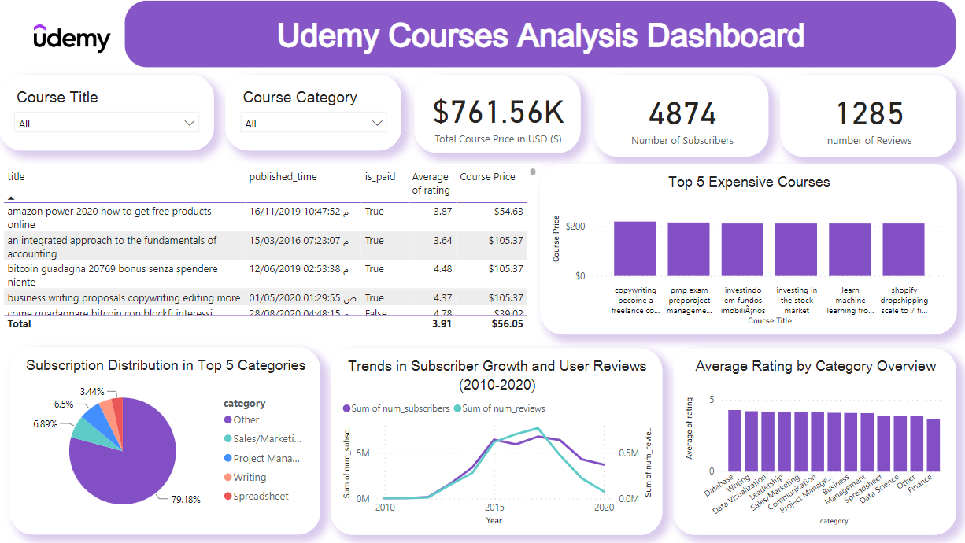

Slide 11
TOTAL COURSES PRICE IN USD $
NUMBER OF SUBSCRIBERS
761.5K $
4874
Some Cards to Interpret Data
It's a first part from Our Dashboard
NUMBER OF REVIEWS
1285

Slide 12



Top Three Expensive Courses
Copywriting become a Freelancer Copywriter in 7 Days
218.7$
PMP Exam Preproject Management Professional Full training
214.6$
210.7$
investindo em fundos imobiliÃ¡rios

Slide 13
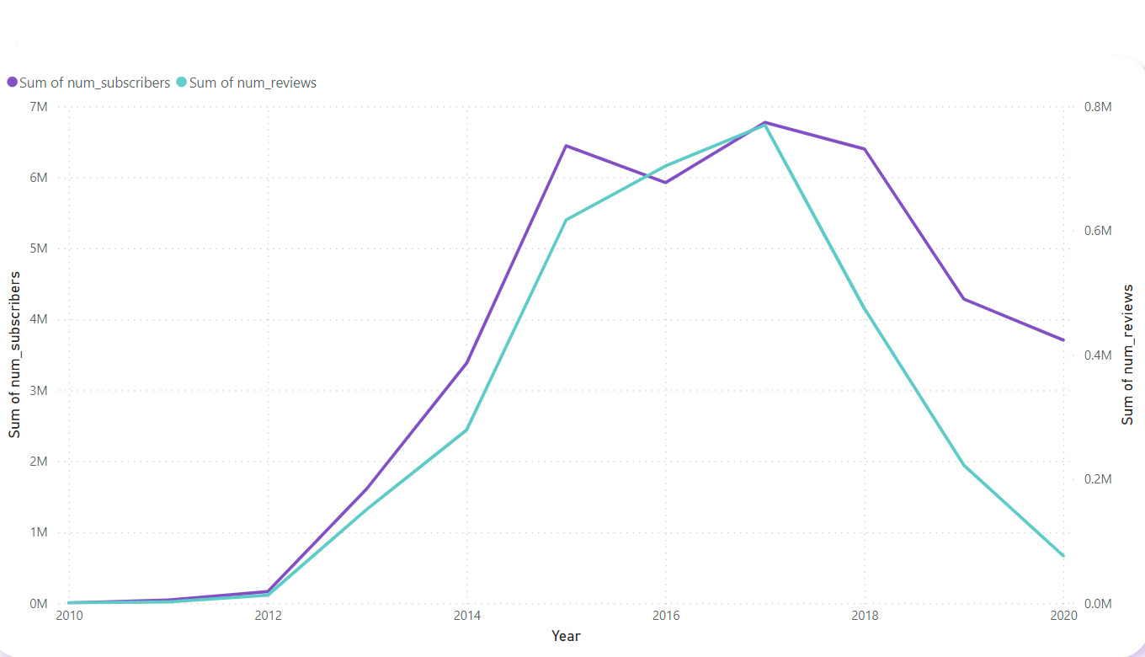
TRENDS IN SUBSCRIBER GROWTH AND USER REVIEWS (2010-2020)
OVERVIEW OF THE DATA CAPTURED OVER A DECADE, HIGHLIGHTING KEY CHANGES IN SUBSCRIBER NUMBERS AND USER REVIEWS.

Slide 14





Growth and Decline of Udemy Financial Courses
2010
2016
2020
Subscribers nearing zero, reviews minimal.
Subscribers peaking at 7 million, reviews approaching 800,000.
Subscribers at 4 million, reviews near record lows.
2013
2018
Subscribers surpassing 2 million, reviews growing rapidly.
Subscribers declining to 5 million, reviews slowing down.

Slide 15
Revitalizing Growth: Strategic Recommendations
GAMIFICATION FEATURES
Implement gamification features like badges, leaderboards, and challenges to boost user engagement and make the learning experience more interactive and rewarding.
COMMUNITY ENGAGEMENT
Introduce or enhance features that facilitate community engagement, such as discussion forums, study groups, and peer-to-peer learning opportunities.
PERSONALIZED RECOMMENDATIONS
Leverage user data and machine learning algorithms to offer personalized course recommendations, tailored to individual interests and learning preferences.
TARGETED MARKETING CAMPAIGNS
Develop targeted marketing campaigns based on user demographics, interests, and behavior to attract new subscribers and retain existing ones.
INFLUENCER COLLABORATIONS
Collaborate with influential figures in the financial industry to create exclusive content and leverage their following for user acquisition.
USER EXPERIENCE OPTIMIZATION
Conduct usability testing and continuously optimize the user experience, focusing on ease of navigation, content accessibility, and overall satisfaction.

Slide 16
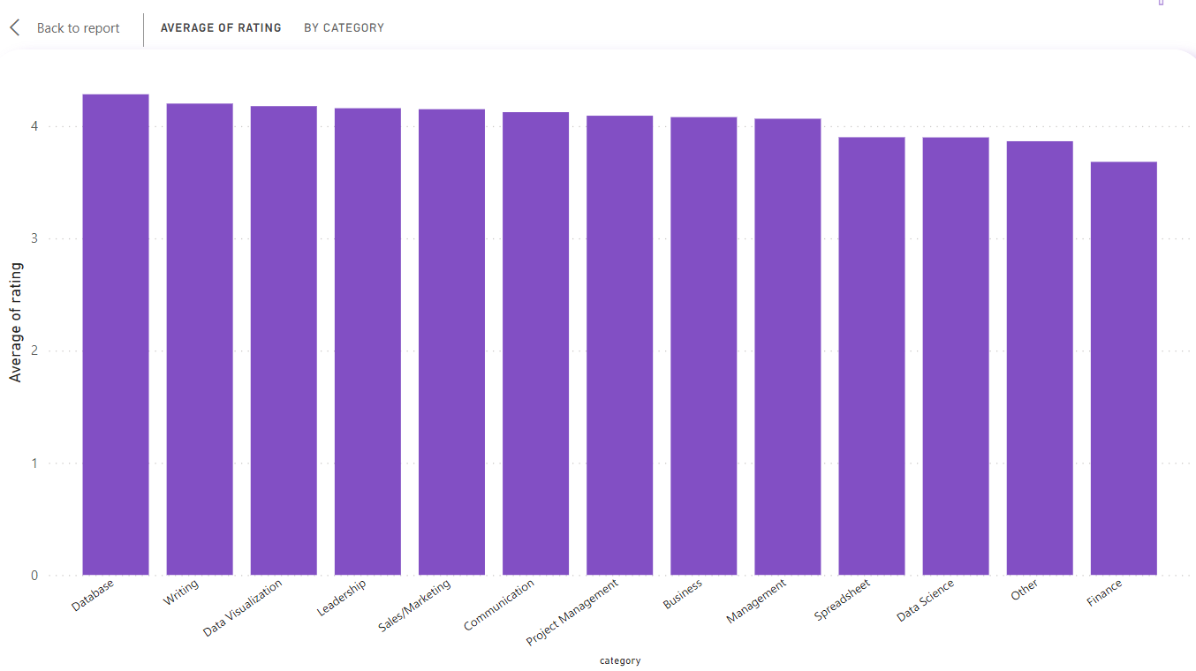
AVERAGE RATING BY CATEGORY OVERVIEW
INTRODUCTION TO THE DATA PRESENTED, EXPLAINING THE SCOPE OF CATEGORIES RATED AND THE PURPOSE OF THE RATINGS.

Slide 17
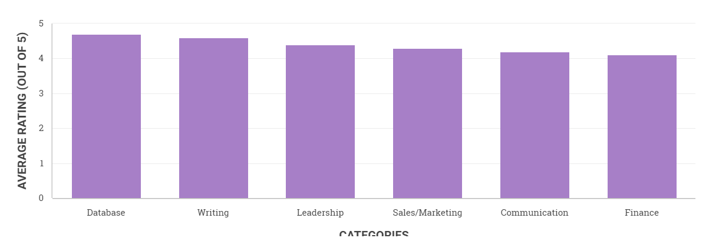
Top Performing Categories in Ratings
DATABASE AND WRITING COURSES STAND OUT WITH HIGH USER SATISFACTION, WHILE FINANCE COURSES MAY BENEFIT FROM IMPROVEMENTS.

Slide 18
Strategic Recommendations for Improving Category Ratings
ENHANCE COURSE MATERIALS
PROVIDE INSTRUCTOR TRAINING
ALIGN WITH INDUSTRY TRENDS
Invest in developing high-quality, interactive, and visually engaging course materials to improve the overall learning experience. Regularly update content to ensure it aligns with industry best practices and emerging technologies.
Implement comprehensive training programs for instructors to enhance their teaching skills, delivery methods, and subject matter expertise. Encourage the use of practical examples, real-world case studies, and hands-on activities to reinforce learning.
Continuously monitor industry trends, market demands, and emerging technologies to ensure course content remains relevant and valuable. Collaborate with subject matter experts and industry professionals to identify and address skill gaps.
ENCOURAGE STUDENT FEEDBACK
LEVERAGE LEARNING ANALYTICS
FOSTER PEER LEARNING
Establish a robust feedback mechanism to gather insights from students on their learning experiences, areas for improvement, and desired topics. Analyze feedback data to identify opportunities for enhancing course quality and meeting student expectations.
Utilize learning analytics to track student engagement, performance, and satisfaction levels across different courses and categories. Identify areas for improvement based on data-driven insights and implement targeted strategies to optimize learning outcomes.
Encourage peer-to-peer learning and collaboration through discussion forums, group projects, and interactive activities. This approach can enhance knowledge sharing, reinforce concepts, and foster a supportive learning community.

Slide 19
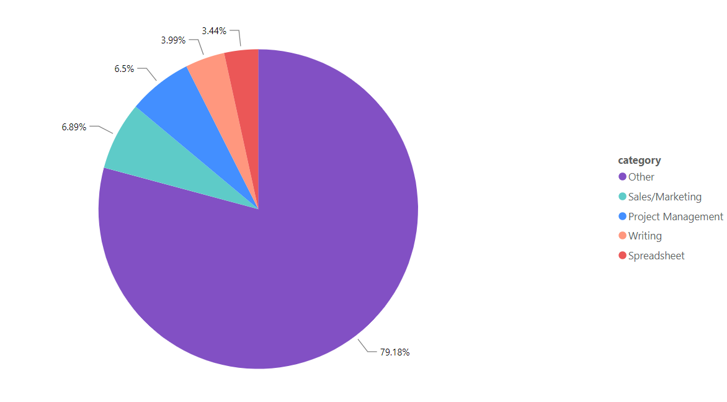
SUBSCRIPTION DISTRIBUTION IN TOP 5 CATEGORIES
BRIEFLY INTRODUCE THE SCOPE OF THE DATA, EXPLAINING THAT THIS ANALYSIS COVERS THE DISTRIBUTION OF SUBSCRIPTIONS ACROSS VARIOUS CATEGORIES

Slide 20
Predominant Subscription Category
OVERWHELMING MAJORITY
POTENTIAL REASONS FOR DOMINANCE
The 'Other' category accounts for a staggering 79.18% of total subscriptions, highlighting the vast diversity of topics and courses that transcend traditional category boundaries.
This dominance could stem from the ever-evolving nature of knowledge and skills, with many niche areas not fitting neatly into predefined categories. Additionally, subscribers may seek multi-disciplinary or interdisciplinary courses that blend various subjects.
NEED FOR MORE GRANULARITY
DIVERSE SUBSCRIBER BASE
The substantial percentage in the 'Other' category suggests a potential need for more granular categorization to better understand subscriber interests and market trends, enabling more targeted content development and marketing strategies.
The popularity of the 'Other' category could also indicate a diverse subscriber base with varied interests and career goals, seeking specialized knowledge or skills that cater to their unique needs.

Slide 21
Conclusion
KEY FINDINGS SUMMARY
STRATEGIC INSIGHTS
RECOMMENDATIONS
Diverse course offerings cater to various learning needs, with predominant categories being 'Other', Writing, Project Management, and Sales/Marketing.
The 'Other' category's dominance suggests diverse and specific user needs not fully captured by traditional categories. There's substantial opportunity for specialization in areas like Project Management and Writing.
Expand course categories to align better with user demands and capture the full spectrum of interests. Tailor marketing strategies based on category popularity and continue leveraging data analytics to monitor course performance and evolve with market demands.

